Slide 1
B09S0061 Software Engineering
Lecture 4
Instructor: Liu, Guangchi Ph.D.
2024/03/14
Notes:
本模板基于“中国科学院大学-路人丁-PPT模板”魔改而成，著作权归该作者所有。
本模板中使用的东南大学校徽、校标文字组合、校训文字等素材来自于微信公众号“金木屋”。
本模板的视觉设计参考了“东南大学视觉识别系统”。
人物介绍页头像素材来自 小肥柴。
本模板力求简洁，布局合理，主次分明。以学术风为设计理念，适用于学术报告与论文答辩等相关应用场景。模板未使用任何动画效果。
您仅可以以个人非商业用途使用本PPT模板，不可将信息内容的全部或部分用以出售，或以出租、出借、转让、分销、发布等其他任何方式供其他人使用。
欢迎 持续关注东南大学止于至善学术风 PPT 模板 （https://zhuanlan.zhihu.com/p/335298500）后续的功能优化及多语言更新版本。
最后，祝汇报顺利，马到成功！
Version: (2021) v1.5-en.

Slide 2
Heads Up
1st Assignment will be uploaded to 微助教 next Monday， Due on Mar 23rd, 23:55 pm
Register a student account on 微助教
用户名：本人实名；序号：一卡通号； 学号：学号
Join class (课程码 ON996)
Go to 作业/Assignment 1
Submit your answers on Answer Sheet 1.docx

Slide 3
Developing a Scenario with a Client: a Typical Student
Purpose:
Scenario that describes the use of an online Exam system by a representative student [Which viewpoint is this scenario based upon?]
Individual:
[Who is a typical student?] Student A, major in computer science. [Where can the student be located? Do other universities differ?]
Equipment:
Any computer with a supported browser. [Is there a list of supported browsers? Are there any network restrictions?]
Scenario:
Student A authenticates. [How does a college student authenticate?]
Student A starts browser and types URL of Exam system. [How does the student know the URL?]
Exam system displays list of options. [Is the list tailored to the individual user?]

Slide 4
Developing a Scenario with a Client (continued)
4. Student A selects Exam 1
A list of questions is displayed, each marked to indicate whether completed or not. [Can the questions be answered in any order?]
Student A selects a question and chooses whether to submit a new answer or edit a previous answer. [Is it always possible to edit a previous answer? Are there other options?]
[What types of question are there: text, multiple choice, etc.?] The first question requires a written answer. Student A is submitting a new answer. The student has a choice whether to type the solution into the browser or to attach a separate file. Student A decides to attach a file. [What types of file are accepted?]

Slide 5
Developing a Scenario with a Client (continued)
8. For the second question, the student chooses to edit a previous answer. Student A chooses to delete a solution previously typed into the browser, and to replace it with an a[ached file. [Can the student edit a previous answer, or must it always be replaced with a new answer?]
9. As an alternative to completing the entire exam in a single session, Student A decides to saves the completed questions to continue later. [Is this always permitted?]
10. Student A logs off.
11. Later Student A log in, finishes the exam, submits the answers, and logs out. [Is this process any different from the initial work on this exam?]
12. The Student A has now completed the exam. The student selects an option that submits the exam to the grading system. [What if the student has not attempted every question? Is the grader notified?]

Slide 6
Discussion
Scenario that describes the use of an online Exam system from a teacher’s viewpoint
Purpose:
Individual:
Equipment:
Scenario Steps:
Will be presented in next class!

Slide 7
Developing a Scenario with a Client (continued)
Developing a scenario with a client clarifies many functional requirements that must be agreed before a system can be built, e.g., policies, procedures, etc.
The scenario will often clarify the requirements for the user interface, but the design of the user interface should not be part of the scenario.
Although this scenario is quite simple, many details have been left out.
A complex system might need many scenarios.

Slide 8
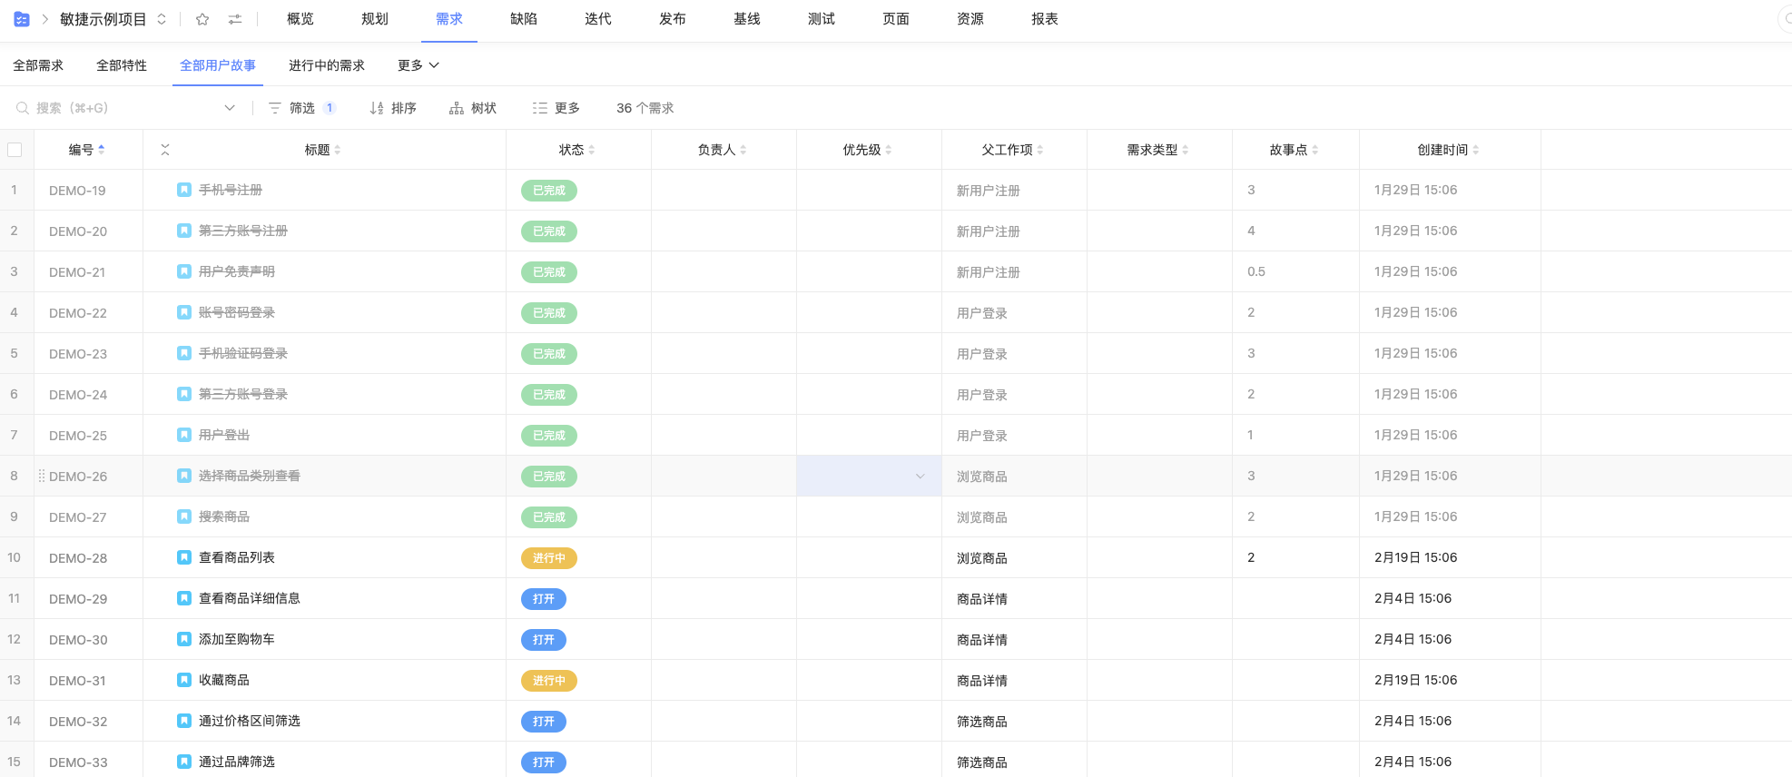

Slide 9
Scenarios for Analyzing Special Requirements
Scenarios are very useful for analyzing special requirements.
Examples
Reversals. In a financial system, a transaction is credited to the wrong account. What sequence of steps are used to reverse the transaction?
Errors. A mail order company has several copies of its inventory database. What happens if they become inconsistent?
Scenarios for error recovery
Murphy's Law: "If anything can go wrong, it will". Create a scenario for everything that can go wrong and how the system is expected to handle it.
Also useful in Quality Assurance

Slide 10
Modeling Scenarios as Use Cases
Models
Scenarios are useful in discussing a proposed system with a client, but requirements need to be made more precise before a system is fully understood.
This is the purpose of requirements modeling.
A use case provides such a model.

Slide 11
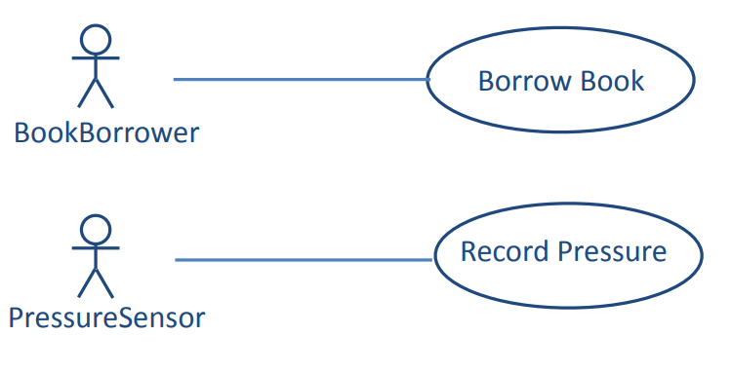
Two Simple Use Cases
Actor
Use Case
Association

Slide 12
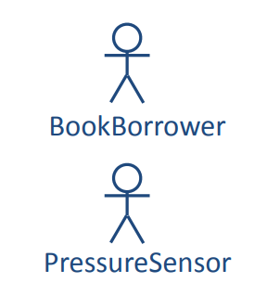
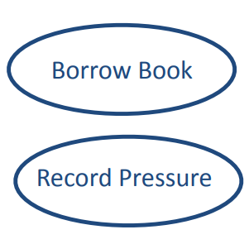
Actor and Use Case Diagram
An actor is a user of a system in a particular role.
An actor can be human or an external system.
A use case is a task that an actor needs to perform with the help of the system.

Slide 13
Use Cases and Actors
Actor is role, not an individual (e.g., librarian can have many roles)
Actor must be a beneficiary of the use case (e.g., not librarian who processes book when borrowed)
In naming actors, choose names that describe the role, not generic names, such as "user" or "client".

Slide 14
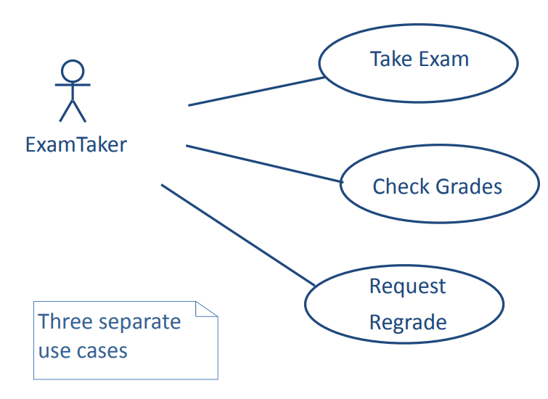
Use Cases for Exam System

Slide 15
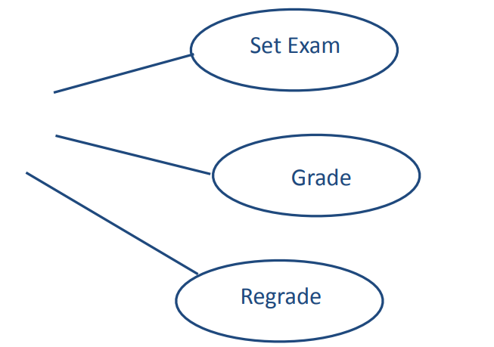

Use Cases for Exam System (continued)
Note that actor is a role. An individual can be an ExamTaker on one association and an Instructor at a different time.

Slide 16
Describing a Use Case
Some organizations have complex documentation standards.
Metadata
The name of the use case
Goal of the use case
The actor or actors
Trigger
Entry conditions at beginning
Post conditions at end
Flow of events
The basic flow of events
Alternate flows of events
Exceptions

Slide 17
Take Exam Use Case: Basic Flow
Basic flow of events:
1. ExamTaker connects to the server.
2. The server checks whether ExamTaker is already authenticated and runs authentication process if necessary.
3. ExamTaker selects an exam from a list of options.
4. ExamTaker repeatedly selects a question and either types in a solution, attaches a file with a solution, or edits a solution.
5. ExamTaker either submits completed exam or saves current state.
6. When a completed exam is submitted, the server checks that all questions have been attempted and sends acknowledgement to ExamTaker.
7. ExamTaker logs out.

Slide 18
Take Exam Use Case: Alternate Flow
Alternate flows and exceptions model paths through the use case other than the basic flow.
In the following list, each flow is linked to a step of the basic flow.
Alternate flows are alternative paths to successful completion of the use case.
3. ExamTaker has previously entered part of the exam, but not submitted it.
4. Solution file not accepted by system.
6. Incomplete submission.
Exceptions lead to failure of the use case.
2. Authentication failure

Slide 19
The <<extends>> Relationship
The «extends» relationship
Uses cases can make use of other use cases
If an alternate flow or an exception needs extra detail, it can be modeled as a separate use case using the «extends» relationship.

Slide 20
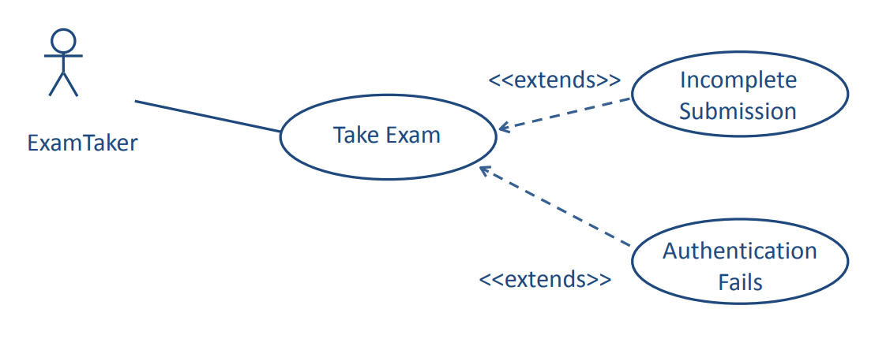
Relationships Between Use Cases: <<extend>>

Slide 21
The <<includes>> Relationship
The «includes» relationship
The «includes» relationship allows a use case to include the steps from another use case.
This is valuable when the included use case occurs in other contexts. It is often developed independently.

Slide 22
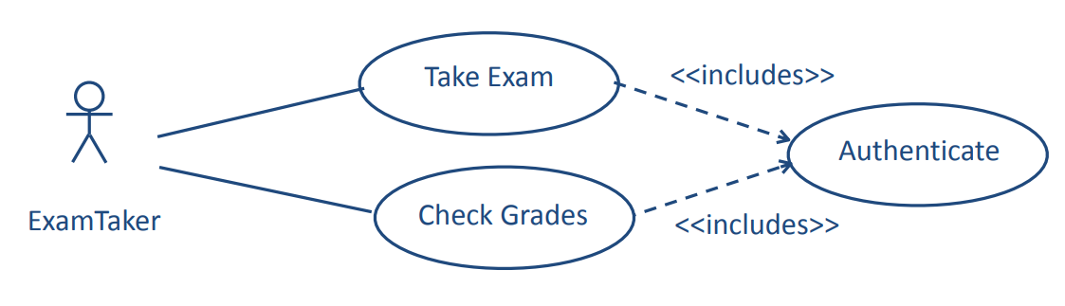
Relationships Between Use Cases: <<includes>>
The Authenticate use case may be used in other contexts.

Slide 23
Scenarios and Use Cases in the Development Cycle
Scenarios and use cases are both intuitive -- easy to discuss with clients
Scenarios are a tool for requirements analysis.
They are useful to validate use cases and in checking the design of a system.
They can be used as test cases for acceptance testing.
Use cases are a tool for modeling requirements.
A set of use cases can provide a framework for the requirements specification.
Use cases are the basis for system and program design, but are often hard to translate into class models.

Slide 24
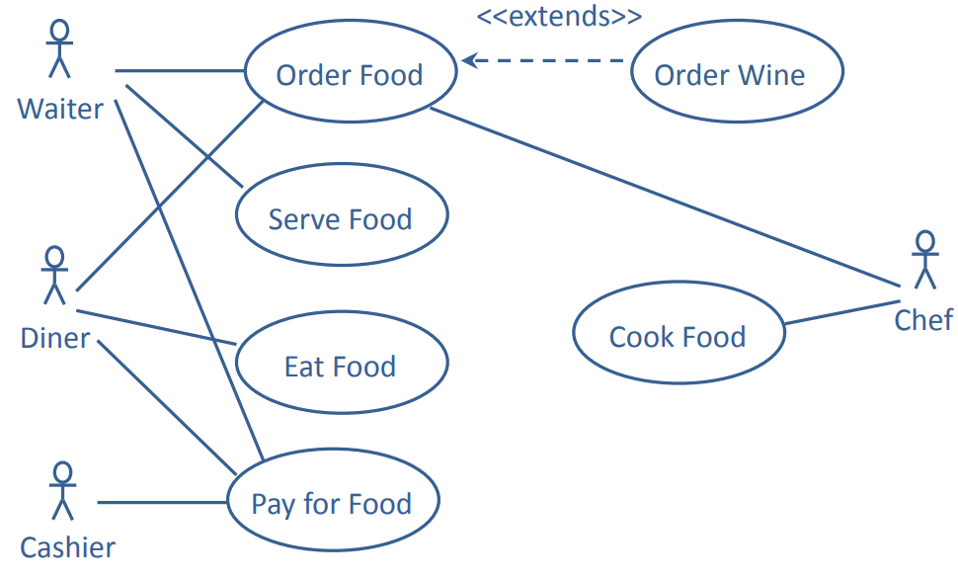
Use Cases with Several Actors
This is why you learn OOP!

Slide 25
Use Case Diagrams
Use case diagrams
A use case diagram shows the relationships between actors and their interactions with a system.
It does not show the logic of those interactions

Slide 26
An Old Examination Question
The Pizza Ordering System
The Pizza Ordering System allows the user of a web browser to order pizza for home delivery. To place an order, a shopper searches to find items to purchase, adds items one at a time to a shopping cart, and possibly searches again for more items.
When all items have been chosen, the shopper provides a delivery address. If not paying with cash, the shopper also provides credit card information.
The system has an option for shoppers to register with the pizza shop. They can then save their name and address information, so that they do not have to enter this information every time that they place an order.
Develop a use case diagram, for a use case for placing an order, PlaceOrder. The use case should show a relationship to two previously specified use cases, IdentifyCustomer, which allows a user to register and log in, and PaybyCredit, which models credit card payments.

Slide 27
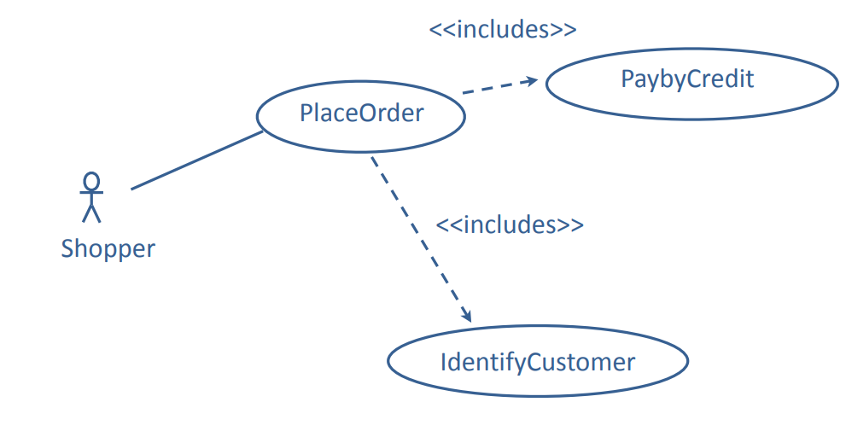
An Old Examination Question
Correct solution

Slide 28
Discussion
Create ordering system use cases with shopper, cashier and deliverer

Slide 29
Requirements on Final Project
5. Present your scenarios and use case diagrams in your final report
6. Organize you code in OOP style

Slide 30
03
PART THREE
Model for Requirements

Slide 31
Models for Requirements
As you build understanding of the requirements through viewpoint analysis, scenarios, use cases, etc., use models to analyze and specify requirements. The models provide a bridge between the client's understanding and the developers’.
The craft of requirements analysis and specification includes selecting the appropriate tool for the particular task.
A variety of tools and techniques.
Many familiar from other courses.
No correct technique that fits all situations.

Slide 32
Models: Useful Text
Grady Booch, James Rumbaugh, Ivar Jacobson, The Unified Modeling Language. Addison-Wesley 1999.
Grady Booch, et al., Object-Oriented Analysis and Design with Applications, third edition. Benjamin/Cummings 2007.
Rob Pooley, Perdita Stevens, Using UML Software Engineering with Objects and Components, second edition. Addison-Wesley 2005.

Slide 33
Models
A model is a simplification of reality
We build models so that we can better understand the system we are developing.
We build models of complex system because we cannot comprehend such a system in its entirety.
Models can be informal or formal. The more complex the project the more valuable a formal model becomes.

Slide 34
Principles of Modeling
The choice of what models to create has a profound influence on how a problem is attacked and how a solution is shaped.
No single model is sufficient. Every nontrivial system is best approached through a small set of nearly independent models.
Every model can be expressed at different levels of precision.
Good models are connected to reality.

Slide 35
The Unified Model Language
UML is a standard language for modeling software systems
Serves as a bridge between the requirements and the implementation.
Provides a means to specify and document the design of a software system.
It is intended to be process and programming language independent, but is particularly suited to object-oriented program development.

Slide 36
Models: Diagrams and Specification in UML
In UML, a model consists of a diagram and a specification.
A diagram is the graphical representation of a set of elements, usually rendered as a connected graph of vertices (things) and arcs (relationships).
Each diagram is supported by technical documentation that specifies in more detail the model represented by the diagram.
A diagram without a specification is of little use

Slide 37
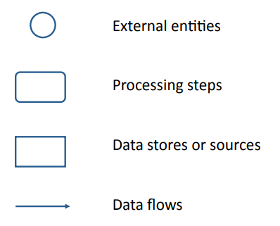
Data-Flow Models
An informal modeling technique to show the flow of data through a system.

Slide 38
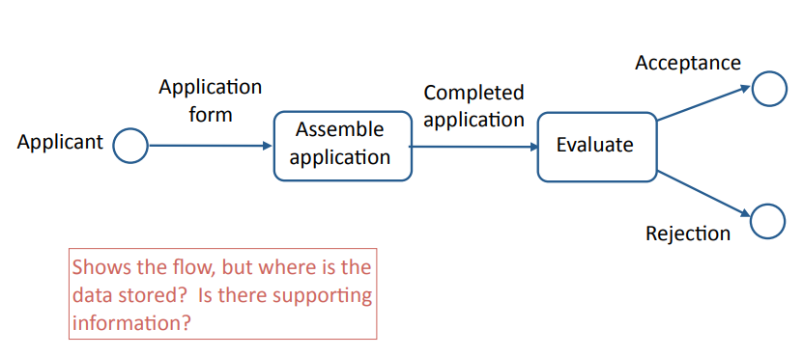
Data-Flow Model Example: University Admissions
Any Problem?

Slide 39
Data-Flow Model Example: University Admissions

Slide 40
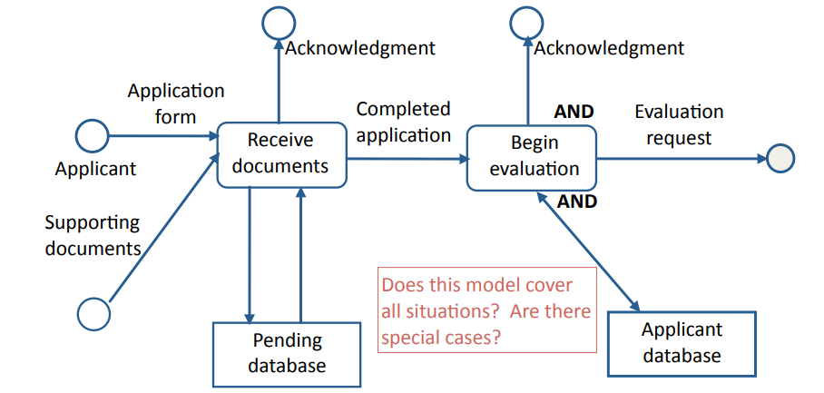
Data-Flow Model Example: Assemble Application
Any Problem?

Slide 41
Data-Flow Model Example: Assemble Application

Slide 42
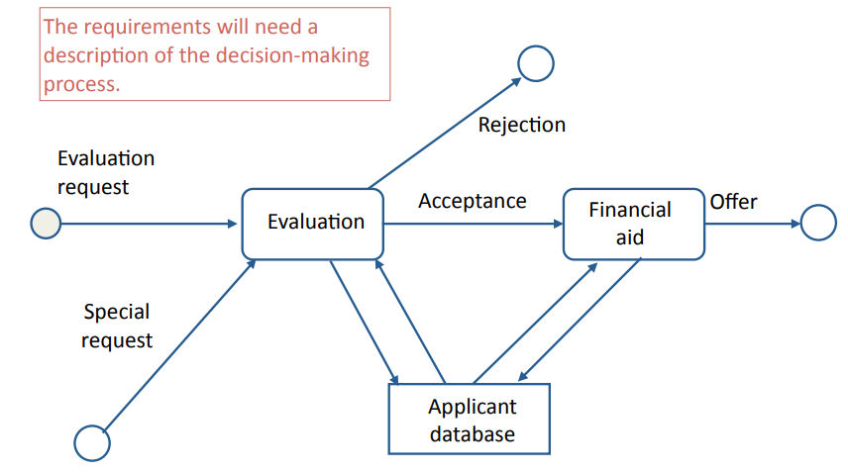
Data-Flow Model Example: Process Completed Application
When to use Data-Flow Model?

Slide 43
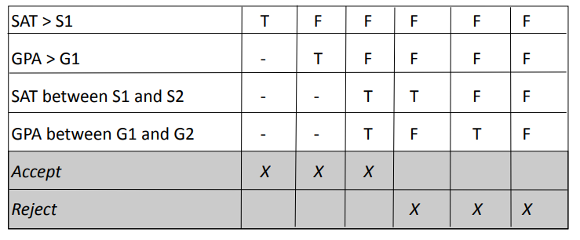
Decision Table Model
University Admission Decision
Each column is a separate decision case. The columns are processed from left to right. Note that the rules are specific and testable.
Recall any model you learned previously?

Slide 44
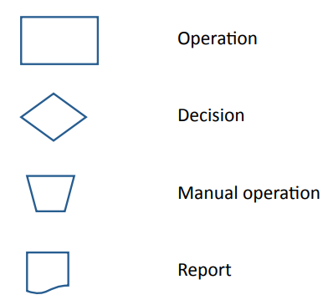
Flowchart Models
An informal modeling technique to show the logic of part of a system and paths that data takes through a system.

Slide 45
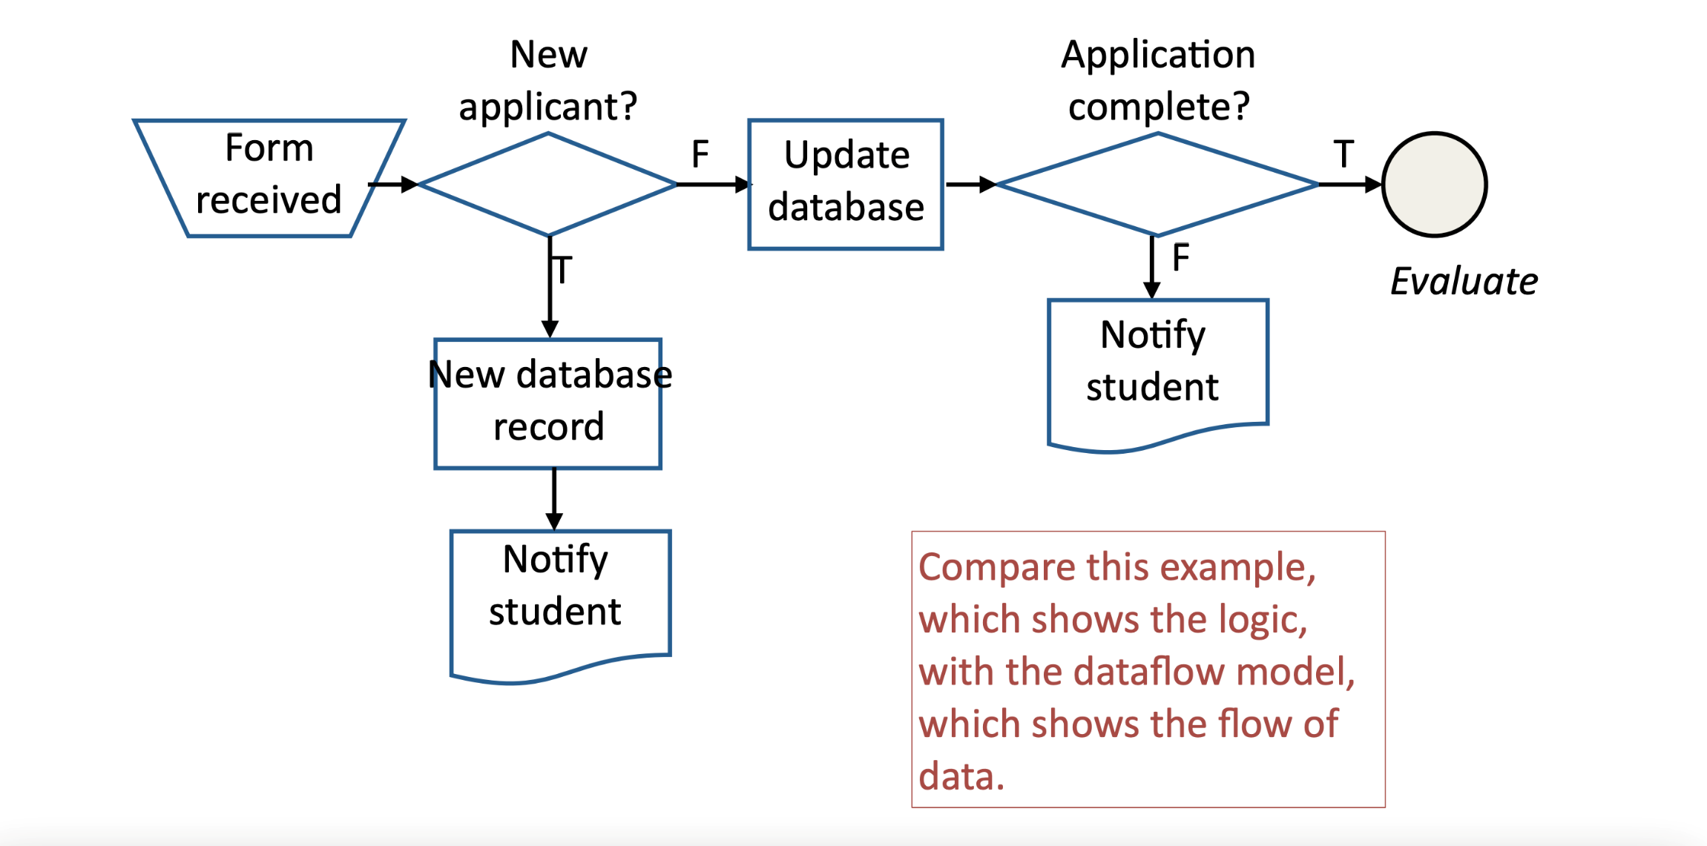
Example: University Admissions Assemble Application
When to use Flowchart?

Slide 46
Modeling Tools: Pseudo-code
An informal modeling technique to show the logic behind part of a system.
Example: University Admission Decision
admin_decision (application)
if application.SAT == null then error (incomplete)
if application.SAT > S1 then accept(application)
else if application.GPA > G1 then accept(application)
else if application.SAT > S2 and application.GPA > G2
then accept(application)
else reject(application)
The notation used for pseudo-code can be informal, or a standard used by a software development organization, or based on a regular programming language. What matters is that its interpretation is understood by everybody involved.

Slide 47
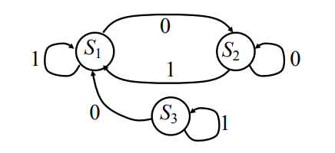
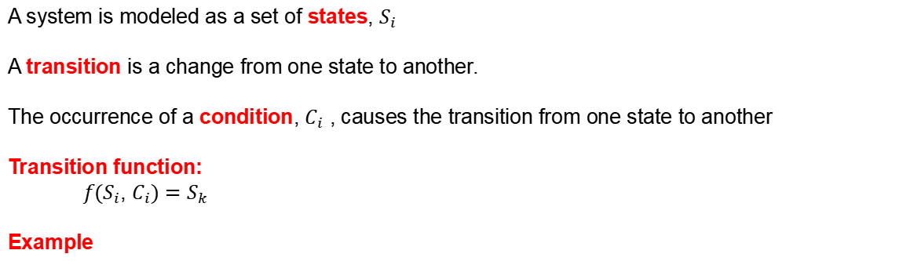
Modeling Tools: Transition Diagrams
A system is modeled as a set of states, $S_{i}$
A transition is a change from one state to another.
The occurrence of a condition, $C_{i}$ , causes the transition from one state to another
Transition function:
${f(S}_{i}$, $C_{i})=$ $S_{k}$
Example

Slide 48
Finite State Machine Model Therapy Control Console
Example: Radiation Therapy Control Console.
You are developing requirements for the operator's control console.
In an interview, the client describes the procedures that the operator must follow when operating the machine.
You use a finite state machine model to specify the procedures.
This shows the client that you understand the requirements and specifies the procedures for the developers.

Slide 49
Finite State Machine Model Therapy Control Console: Scenario
Scenario
The client provides the following rough scenario.
"The set up is carried out before the patient is made ready. The operator selects the patient information from a database. This provides a list of radiation fields that are approved for this patient. The operator selects the first field. This completes the set up.
"The patient is now made ready. The lock is taken off the machine and the doses with this field are applied. The operator then returns to the field selection and chooses another field."

Slide 50
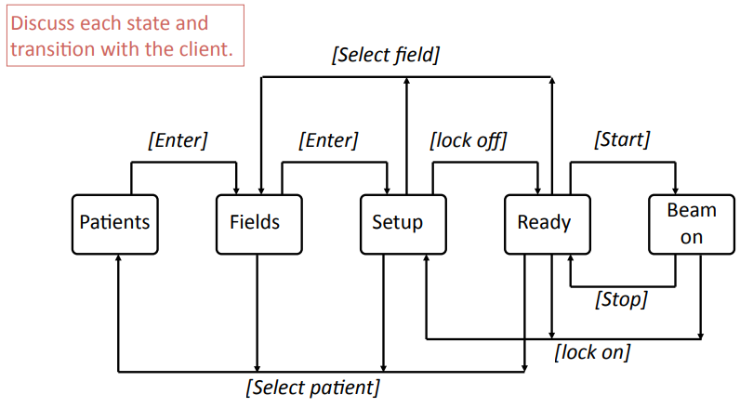

Finite State Machine Model State Transition Diagram
${f(S}_{i}$, $C_{i})=$ $S_{k}$

Slide 51
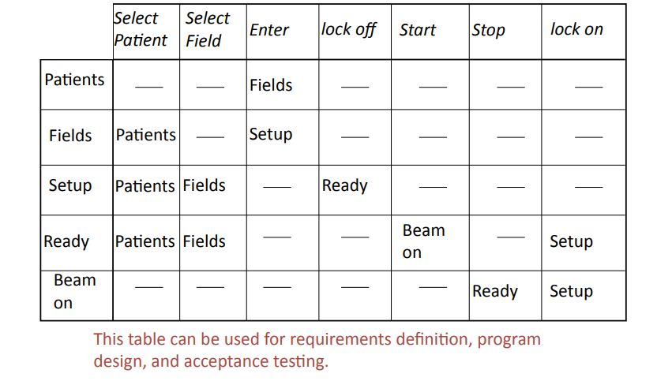
Finite State Machine Model State Transition Table
When to use Transition Diagrams?

Slide 52
Entity-Relation Model
A requirements and design methodology for relational databases
A database of entities and relations
Tools for displaying and manipulating entity-relation diagrams
Tools for manipulating the database (e.g., as input to database design)
Entity-relationship models can be used both for requirements specification and for the design specification.

Slide 53
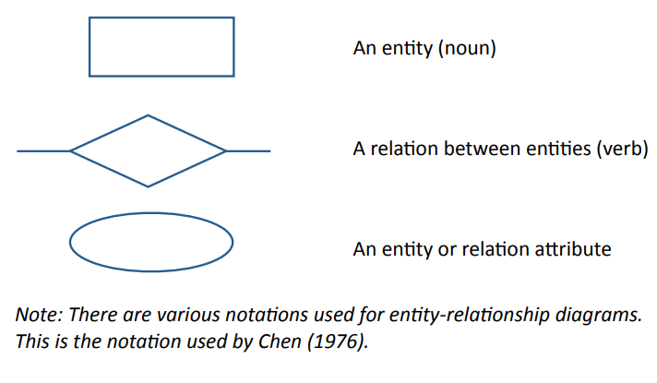
Modeling Tools: Entity-Relation Diagram

Slide 54
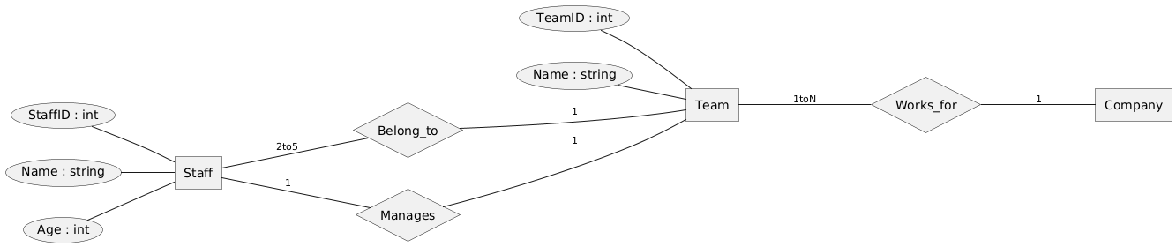
Modeling Tools: Entity Relationship Diagram

Slide 55
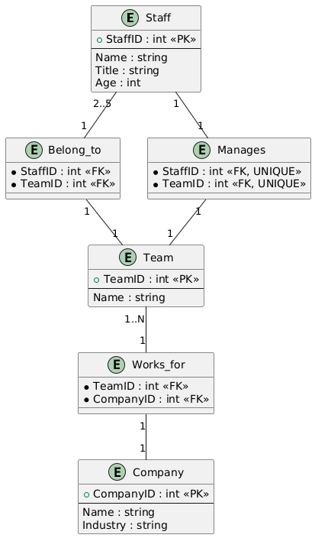
Entity Relationship Diagram as a Design Tool Example: Database Schema for Web Data
When to use Entity Relationship Diagram?

Slide 56
Prototyping Requirements
Rapid prototyping is the most comprehensive of all modeling methods
A method for specifying requirements by building a system that demonstrates the functionality of key parts of the required system
Particularly valuable for user interfaces

Slide 57
Requirements Definition: Data Dictionaries
A data dictionary is a list of names used by the system
Name (e.g., "start_date")
Brief definition (e.g., what is "date")
What is it? (e.g., integer, relation)
Where is it used (e.g., source, used by, etc.)
May be combined with a glossary
As the system is developed, the data dictionary in the requirements is the basis of the system data dictionary, which may be part of the final documentation.

Slide 58
A Note on Class and Object Models
In this course:
Class and object models are used as a tool for program design, not for modeling requirements.
Some people recommend class and object models for requirements definition, but it is difficult to use them without constraining the system design.
Flow charts and finite state machines are supported by UML as design models, but are equally useful for requirements.

Slide 59
Requirements on Final Project
7. Use some requirements modeling diagrams in your final report

